Slide 1
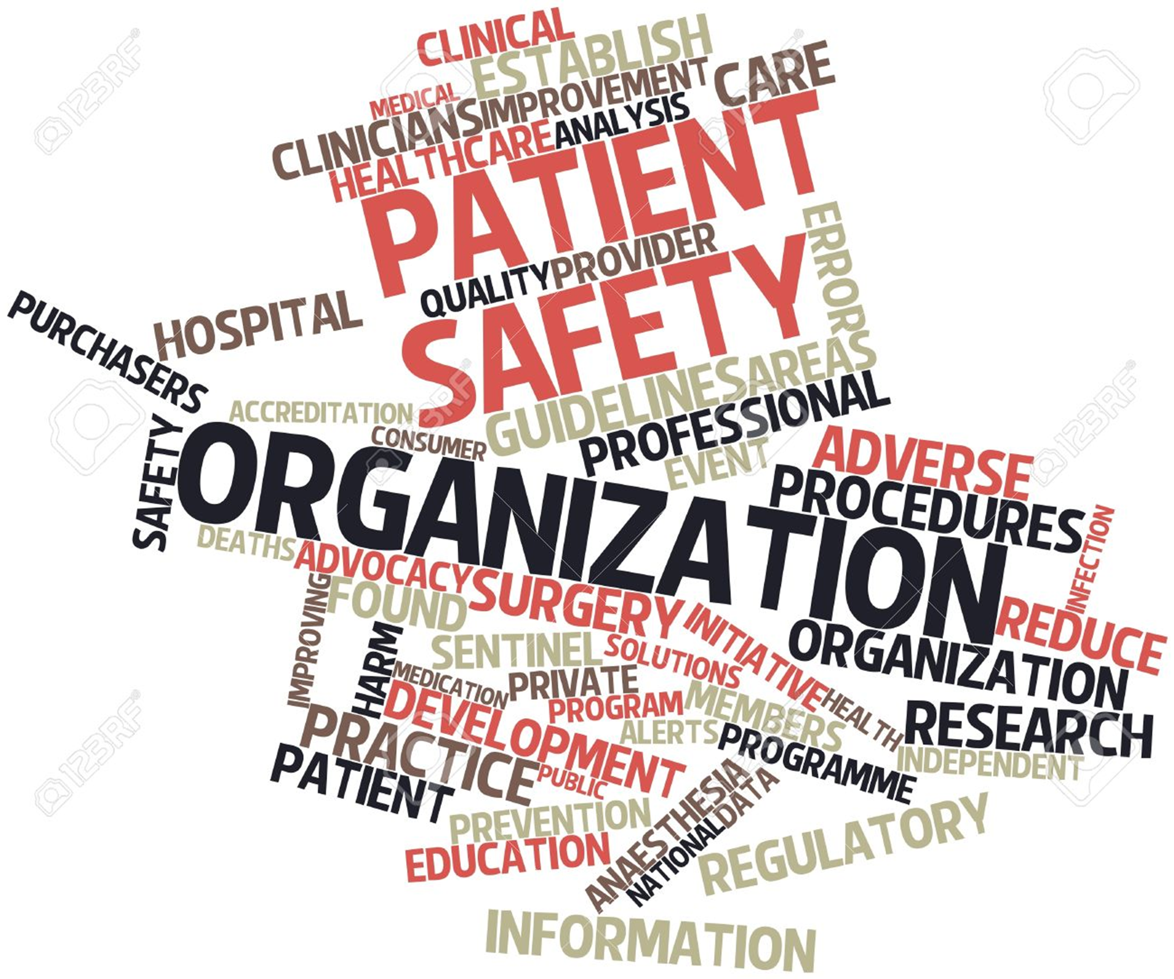
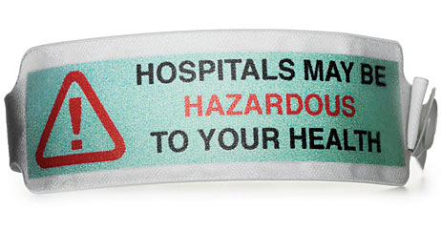
Department of Patient Safety in a Tertiary Care Hospital
-Dr.Kanika Jain
Assistant Professor, Department of Hospital Administration and Officer Incharge, Patient Safety, AIIMS, New Delhi

Slide 2
Definitions….
Patient safety is a health care discipline that emphasizes the reporting, analysis, prevention of medical errors, that often lead to adverse health care events

Slide 3
The Real Harm is Impressive when…
Financial
Resource Utilization
Healthcare System impact is evaluated -----
MEASUREABLE
$17 - 29 billion in lost income, disability and health care costs (USA, IOM Report)

Slide 4
Multiple reports across the globe on adverse events from developed and developing countries have led the World Health Organization to estimate that one in ten persons receiving health care will suffer preventable harm.
1:10

Slide 5
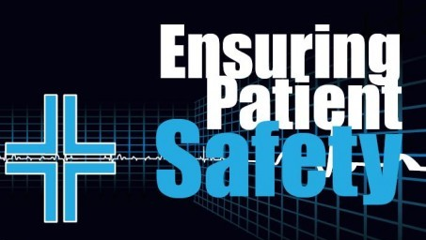
Is our responsibility

Slide 6



Slide 7


Slide 8
How is patient safety achieved
A number of mechanisms are involved in achieving patient safety, including:
High-reliability design: High- reliability designs are resilient even when unpredictable events occur.
“Lean process” and sigma levels
The concept of a multilayered system, in which the failures within each of the layers must be aligned for an error to occur, is known as the “Swiss cheese” model of accident causation.
Error traps (i.e., unpredictable situations in which error is highly likely)
Notes:
The fundamental mechanism by which patient safety can be achieved is high-reliability design, all components of health care delivery must be integrated into a system that is as reliable as possible under complex conditions. A unique feature of high-reliability design comes from complexity theory, which notes that open, interacting systems will produce some level of chaos or inherently unpredictable events.

Slide 9
The ‘Swiss cheese’ model
DEFENCES
Procedures
Physical barriers
Training
THE GAPS
Supervision
Lack of clear
protocols
Drugs: problems with design, packaging and delivery
Lack of knowledge and experience
Patient harm
May be unavailable
Adapted from J. Reason
Notes:
Delays in transfer and handovers (accumulating to 5 hours)
Clinical referral documents misplaced
Hospital transfer: administrative not clinical decision
Equivocation on the diagnosis
Blood and spinal fluid samples misdirected and delayed
Internal ambulance equipment missing and faulty
Protocols inflexible for dealing with emergencies

Slide 10
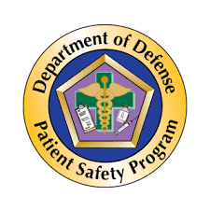
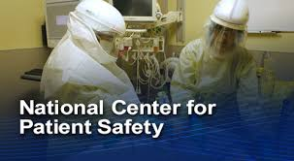
One such concept is …..
Establishment of a Department of Patient Safety in your Hospital

Slide 11

Introduction
Purpose:
The Department of Patient Safety (DPS) aims to
minimize risks,
enhance patient outcomes,
ensure a culture of safety within the hospital

Slide 12
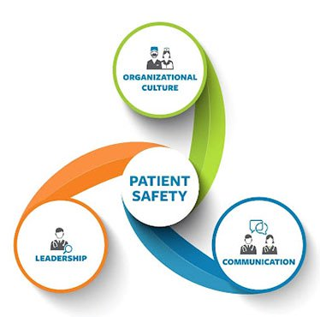
Objectives
To implement protocols that reduce medical errors and adverse events.
To foster a culture of safety through training and awareness programs.
To ensure compliance with national and international safety standards.
To engage patients and families in safety practices

Slide 13

Structure and Staffing
Leadership: Headed by a Chief/ Chief/ Principal Safety Officer, often a senior physician or quality manager.
Team Composition: Multidisciplinary team including:
Physicians
Nurses
Pharmacists
Quality improvement experts
Data analysts
Support Staff: Administrative personnel and IT specialists to maintain safety databases and reporting systems.

Slide 14
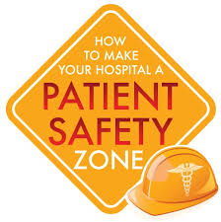
Key Functions
Incident Reporting System:
Risk Assessment:
Patient Safety Initiatives:
Education and Training:

Slide 15
Key Functions
Incident Reporting System:
Risk Assessment:
Patient Safety Initiatives:
Education and Training:
Incident Reporting System:
Establishing a non-punitive reporting culture to encourage staff to report near misses and adverse events.
Use of digital platforms for efficient reporting and tracking.

Slide 16
Key Functions
Incident Reporting System:
Risk Assessment:
Patient Safety Initiatives:
Education and Training:
Risk Assessment:
Regular assessments of clinical practices and procedures to identify potential safety risks.
Implementation of risk management strategies based on findings.

Slide 17
Key Functions
Incident Reporting System:
Risk Assessment:
Patient Safety Initiatives:
Education and Training:
Patient Safety Initiatives:
Development and monitoring of safety protocols (e.g., hand hygiene, surgical safety checklists).
Focus on high-risk areas such as medication safety, infection control, and falls prevention.

Slide 18
Key Functions
Incident Reporting System:
Risk Assessment:
Patient Safety Initiatives:
Education and Training:
Education and Training:
Continuous education programs for staff on patient safety practices and protocols.
Workshops and simulations to prepare staff for emergency situations.

Slide 19
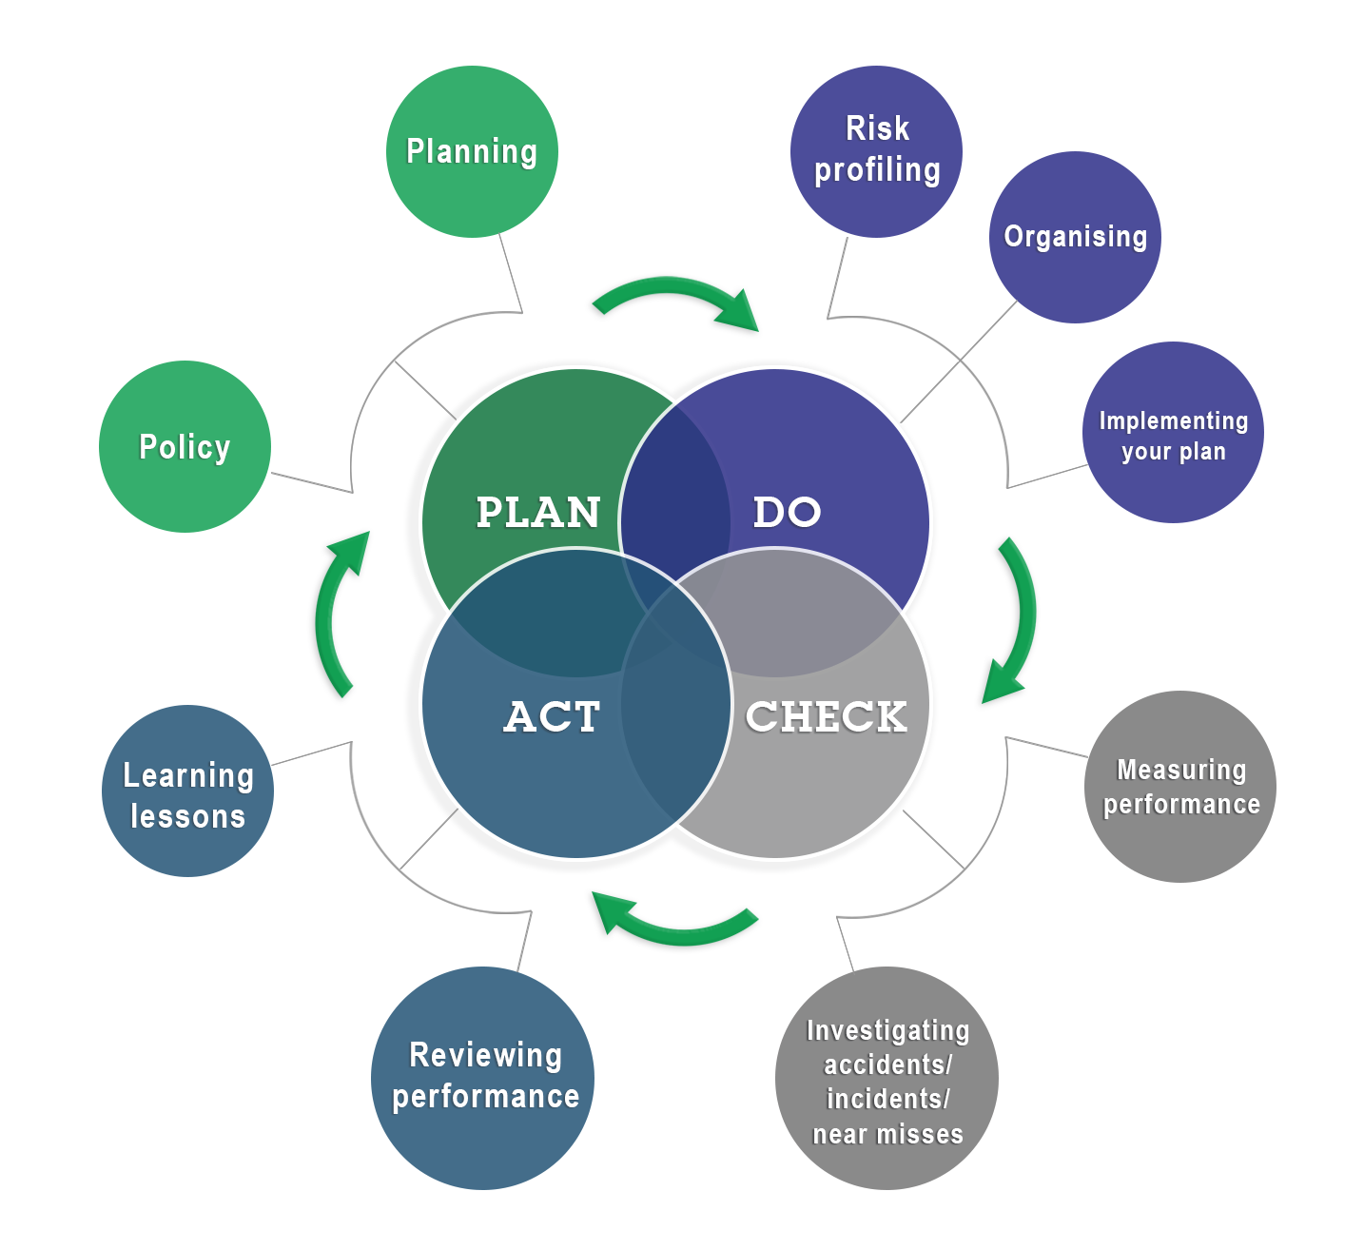
Monitoring and Evaluation
Data Collection:
Collection of data on incidents, patient outcomes, and compliance with safety protocols.
Key Performance Indicators (KPIs):
Metrics to evaluate the effectiveness of safety initiatives (e.g., rate of hospital-acquired infections, medication errors).
Regular Audits:
Conducting periodic audits to assess compliance with safety standards and identify areas for improvement.

Slide 20


Collaboration and Communication
Interdepartmental Collaboration:
Working closely with all departments (e.g., surgery, emergency, pharmacy) to ensure integrated safety practices.
Patient and Family Engagement:
Involving patients and their families in safety discussions, providing education about their roles in ensuring safety.
Stakeholder Communication:
Regular updates to hospital leadership, staff, and stakeholders on safety initiatives and outcomes.

Slide 21

Challenges
Cultural Barriers: Overcoming resistance to reporting and addressing safety issues.
Resource Limitations: Ensuring adequate staffing and funding for safety initiatives.
Training Gaps: Continuous need for up-to-date training as practices and technologies evolve.

Slide 22
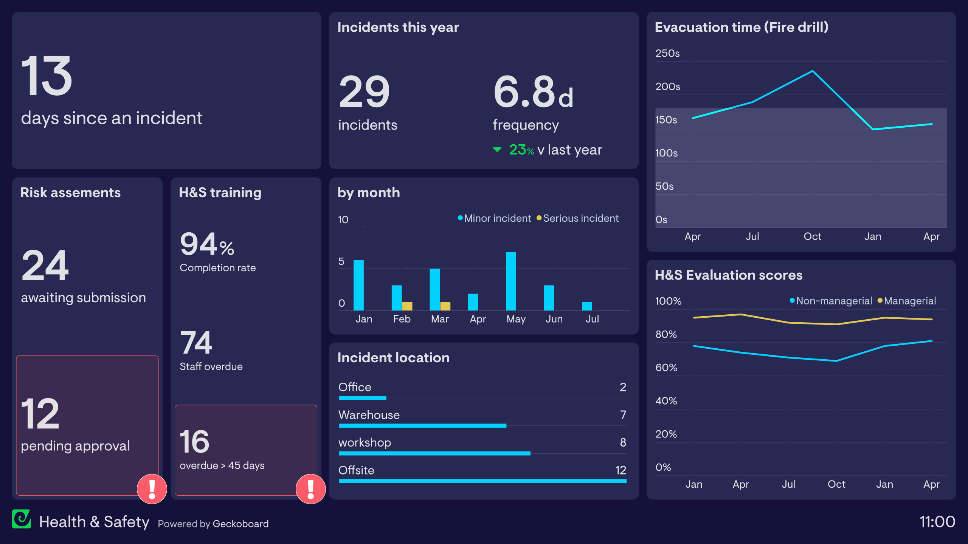
Future Directions
Technology Integration: Utilization of electronic health records and telemedicine to enhance safety monitoring.
Patient Safety Research: Encouraging research to identify innovative solutions and practices in patient safety.
Global Standards Adoption: Aligning with international safety standards and protocols for better outcomes.

Slide 23
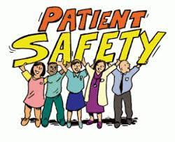
Conclusion
The Department of Patient Safety plays a crucial role in fostering a culture of safety within a tertiary care hospital in India.
Through a structured approach to risk management, education, and collaboration, the department strives to provide the highest level of care and improve patient outcomes.

Slide 24

Thank you!

